Slide 1
Tutorial Air Traffic Survillance

Slide 2
A Mathematical Model for Expected Number of Potential Conflicts

Slide 3
Conflict Prediction Model
Under radar surveillance conditions, ATC is required to ensure that two aircraft are separated at least by 5 nmi.
Whenever this condition is violated, the two aircraft are considered to be in conflict.
Using this definition of conflict a simple Mathematical Model for predicting the expected number of conflicts at an intersection can be developed.

Slide 4
Simple Mathematical Model for Two intersecting Routes
a angle between Routes AB and CD
V average velocity of aircraft on the routes (nmi per hour).
f1 be the expected flow rate along Route AB (aircraft per hour).
f2 be the expected flow rate along Route CD (aircraft per hour).
X minimum separation allowed between two aircraft (typically, 5 nmi).
C
f1
X nmi
f2
α
A
R
O
B
L
Q
P
D

Slide 5
Simple Mathematical Model
Let Aircraft b be at Intersection O and flying toward D.
Where should Aircraft a not be along Route AB at this moment so that:
conflict between Aircraft a and b is not occurring
a conflict will not develop as Aircraft a and b continue to move with velocity V along AB and CD
a conflict would not have occurred in the past if Aircraft b and a were moved backwards.
C
f1
X nmi
f2
α
A
R
O
B
L
Q
P
D

Slide 6
Simple Mathematical Model
Consider first the portion of the route to the left of O.
Let L be a point such that OL = X.
If Aircraft a is between O and L, it is now in conflict with Aircraft b
However, if it is beyond (to the left of) L, it is not now in conflict with b and could not have been in conflict in the past.
As b flies toward D and a flies toward O, the distance between them becomes shortest when the distance of a from O along AO is equal to the distance of b from O along OD.
We must make sure that this shortest distance is >= X.
C
f1
X nmi
f2
α
A
R
O
B
L
Q
P
D

Slide 7
Simple Mathematical Model
Let R be the nearest point to O such that Aircraft a being at this point when Aircraft b is at O, will come at most no closer than X miles to b, as both aircraft continue their flight.
let a be at M and b at N; when the aircraft reach these points,
OM = ON (condition for shortest distance)
But since the aircraft are assumed to travel with the same speed, the distance RM covered by a should be equal to ON--the distance covered by b in the same time period.
RM = ON = OM
f1
C
X nmi
f2
α
A
R
M
O
B
L
α/2
Q
P
N
D

Slide 8
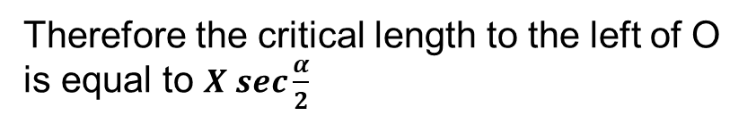

Simple Mathematical Model
Therefore the critical length to the left of O is equal to $X sec\frac{α}{2}$
Since MN = X miles
$$\frac{OM}{1/2(MN)}=sec\frac{α}{2}$$
OM $=\frac{1}{2}\left(MN\right)sec\frac{α}{2}$
OR $=\left(MN\right)sec\frac{α}{2}$
$OR=X sec\frac{α}{2}$
f1
C
X nmi
f2
α
A
R
M
O
B
L
α/2
Q
P
N
D

Slide 9
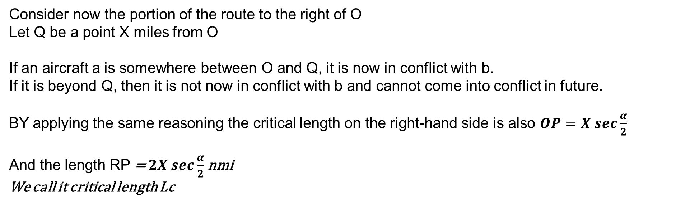
Simple Mathematical Model
Consider now the portion of the route to the right of O
Let Q be a point X miles from O
If an aircraft a is somewhere between O and Q, it is now in conflict with b.
If it is beyond Q, then it is not now in conflict with b and cannot come into conflict in future.
BY applying the same reasoning the critical length on the right-hand side is also $OP=X sec\frac{α}{2}$
And the length RP = $2X sec\frac{α}{2}$ nmi
We call it critical length Lc
f1
C
X nmi
f2
α
A
R
M
O
B
L
α/2
Q
P
N
D

Slide 10
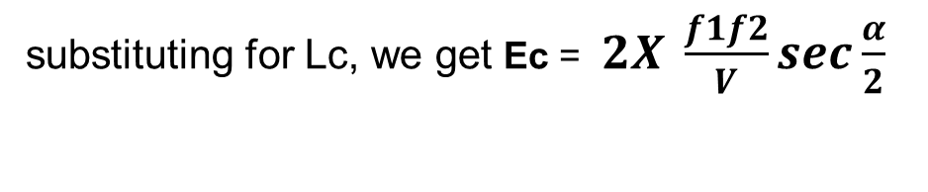
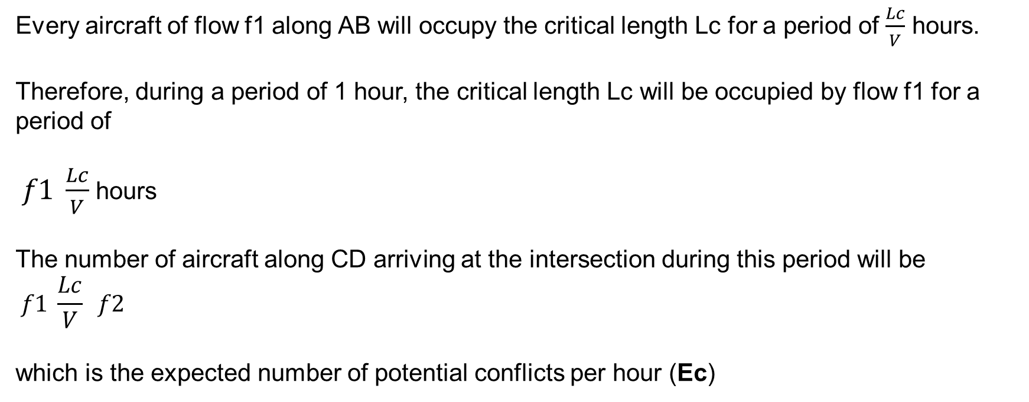
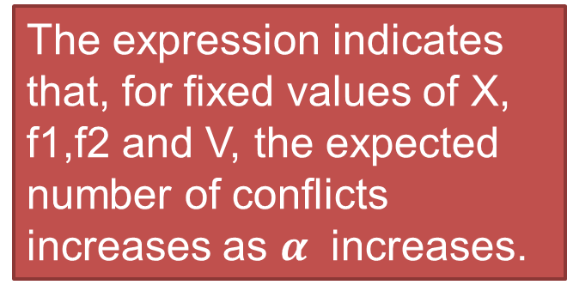
Expected number of Potential Conflicts
Every aircraft of flow f1 along AB will occupy the critical length Lc for a period of $\frac{Lc}{V}$ hours.
Therefore, during a period of 1 hour, the critical length Lc will be occupied by flow f1 for a period of
$f1 \frac{Lc}{V}$ hours
The number of aircraft along CD arriving at the intersection during this period will be
$$f1 \frac{Lc}{V} f2$$
which is the expected number of potential conflicts per hour (Ec)
The expression indicates that, for fixed values of X, f1,f2 and V, the expected number of conflicts increases as $α$ increases.
substituting for Lc, we get Ec = $2X \frac{f1f2}{V}sec\frac{α}{2}$

Slide 11
Capacity at an Intersection
Aircraft capacity at the intersection of two routes would be the maximum allowable value of the product f1 f2 (where f1 and f1 are the flows of aircraft per hour on the two routes) under the following restrictions:
The expected number of potential conflicts per hour does not exceed a certain specified-number
C
f2
f1
α
A
B
D

Slide 12
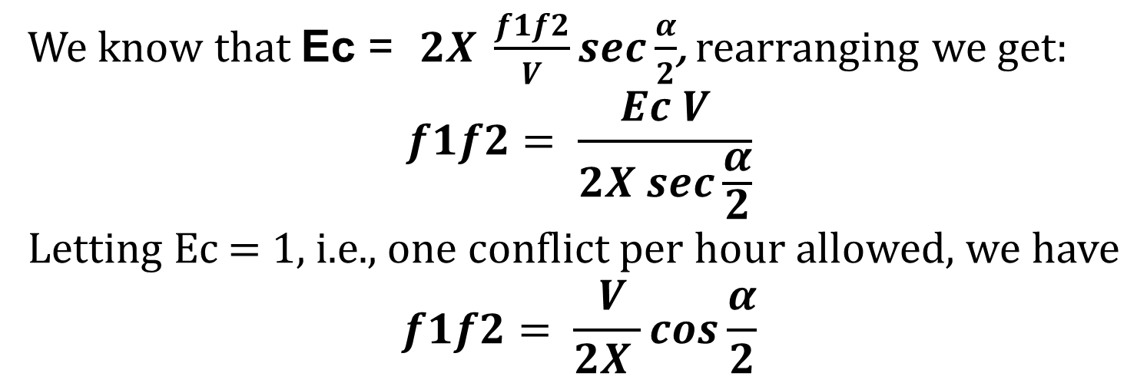
Capacity at an Intersection
We know that Ec = $2X \frac{f1f2}{V}sec\frac{α}{2}$, rearranging we get:
$$f1f2= \frac{Ec V}{2X sec\frac{α}{2}}$$
Letting Ec = 1, i.e., one conflict per hour allowed, we have
$$f1f2= \frac{ V}{2X }cos\frac{α}{2}$$
This expression gives the capacity at an intersection as a function of average aircraft speed V, separation minimum X, and intersection angle α, under the restriction that one conflict per hour is acceptable on the average.
C
f2
f1
α
A
B
D

Slide 13
Tutorial Question 1: Find Capacity at an Intersection
Assuming typical values for V and X to be 600 knots and 5nm find the values for capacity as a function of intersection angle α and plot a figure showing the INTERSECTION CAPACITY AS A FUNCTION OF α
INTERSECTION CAPACITY AS A FUNCTION OF INTERSECTION ANGLE
(One Conflict per Hour Acceptable)
Intersection Angle (α) degrees | Capacity f1 f2 (unit conflict per hour)
10
20
30
45
60
90
120

Slide 14
Tutorial Question 2: Expected number of Potential Conflicts
Assuming typical values for V and X to be 600 knots and 5nm find the Expected number of Potential Conflicts as a function of intersection angle α and plot a figure showing the Potential conflict as a function of α. Assume the flow f1 = 20 aircrafts/hour, f2 = 30 aircrafts/hour.
Potential conflict as a function of conflict Angle
Intersection Angle (α) degrees | Potential conflicts/hour
10
20
30
45
60
90
120

